Slide 1

SRM INSTITUTE OF SCIENCE AND TECHNOLOGY
SCHOOL OF COMPUTING
DEPARTMENT OF COMPUTING TECHNOLOGIES
18CSP109L / 18CSP111L - MAJOR PROJECT / INTERNSHIP
STUDENT ENGAGEMENT MEASUREMENT IN E-LEARNING SYSTEMS
BATCH NO : NW086
TEAM :
Om Rajput (RA1911032010028)
Suyash Nigam (RA1911032010027)
Project Guide :
Dr. TYJ Naga Malleswari

Slide 2
Table of Contents
Project Title and Abstract
Literature Review
Comparison of Existing methods with merits and demerits
Challenges To Address
Problem Statement and Objectives
Architecture diagrams of modules
UML diagrams / ER diagrams/Use case diagram/Activity diagram
Modules Description and Implementation (50%)
Algorithms used
Intermediate Results and Discussion

Slide 3
Objectives of the Project
The task is to implement an online meeting application with a student interactivity measurement feature.
The objectives of this project include -
A meeting platform for students as well as business professionals.
Participant interactivity measurement for the host.
Detailed focus analysis dashboard for the host.

Slide 4
Literature Review
S/No | Paper Title | Author | Year | Journal | Ranking Criterion
 |  |  |  |  | Broad Domain | Existing Systems Addressed | Drawback/Flaws | Problem Addressed | Algorithms/ Tools/ Techniques Used
1 | A survey on: Facial Emotion Recognition and Classification | Manoj Moolchandani; Shivangi Dwivedi; Samarth Nigam; Kapil Gupta | 2021 | IEEE | Image classification | Emotion Detection using computer vision | Misclassified disgust and neutral mood | Face Localization Feature Extraction | CNN
2 | An Integrated Vision System on Emotion Understanding and Identity Confirmation | Yang-Yen Ou; An-Chao Tsai; Jhing-Fa Wang; Po-Chien Lin | 2018 | IEEE | Computer Vision | Emotion Detection using computer vision | Required data for training and subsequent identification is too complicated. | Person identification by posture and facial identifiers. | CNN

Slide 5
S/No | Paper Title | Author | Year | Journal | Ranking Criterion
 |  |  |  |  | Broad Domain | Existing Systems Addressed | Drawback/Flaws | Problem Addressed | Algorithms/ Tools/ Techniques Used
3 | Computer Vision for Attendance and Emotion Analysis in School Settings | Sarah Deniz; Dakyung Lee; Grace Kurian; Lourdes Altamirano; Darren Yee | 2019 | IEEE | Computer Vision | Emotion Detection using computer vision | Requires perfectly aligned cameras for proper data capture. | Can do face detection, face recognition, and emotion analysis | CNN
4 | Neutral Face Classification Using Personalized Appearance Models for Fast and Robust Emotion Detection | Pojala Chiranjeevi; Viswanath Gopalakrishnan; Pratibha Moogi | 2015 | IEEE | Computer Vision | Emotion Detection using computer vision | Required data for training and subsequent identification is too complicated. | Reduced model size to work on mobile devices and tablets. | CNN

Slide 6
Comparison of Existing methods with merits and demerits
Research Paper | Merit | Demerit
A survey on: Facial Emotion Recognition and Classification | Face Localization Feature Extraction | Misclassified disgust and neutral mood
An Integrated Vision System on Emotion Understanding and Identity Confirmation | Person identification by posture and facial identifiers. | Required data for training and subsequent identification is too complicated.
Computer Vision for Attendance and Emotion Analysis in School Settings | Can do face detection, face recognition, and emotion analysis | Requires perfectly aligned cameras for proper data capture.
Neutral Face Classification Using Personalized Appearance Models for Fast and Robust Emotion Detection | Reduced model size to work on mobile devices and tablets. | Required data for training and subsequent identification is too complicated.

Slide 7
Challenges To Address
Due to low Bandwidth issues :
The video is not visible
voice breakage
Infrastructure Issues : The need for a computer, adequate software, constant electricity and high-bandwidth internet is quite a big demand.
Electricity :Many parts of India still have low electricity supply

Slide 8
Problem Statement and Objectives
The task is to implement an online meeting application with a student interactivity measurement feature.
The objectives of this project include -
A meeting platform for students as well as business professionals.
Participant interactivity measurement for the host.
Detailed focus analysis dashboard for the host.

Slide 9
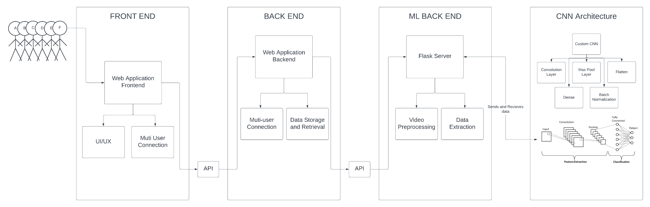
Architecture diagram of modules

Slide 10
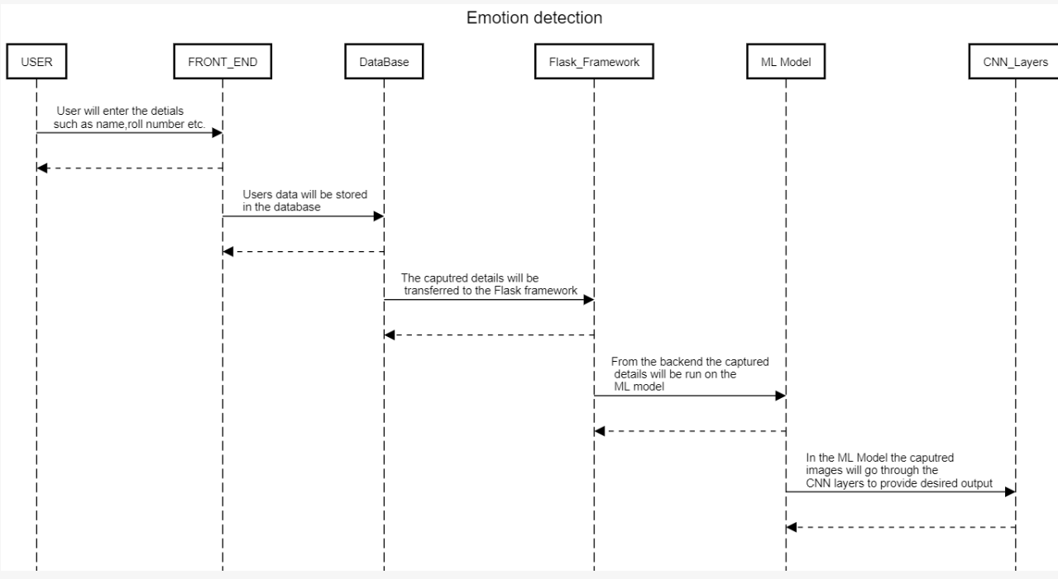
Sequence Diagram

Slide 11
Algorithms used
CNN (Convolution Neural Network) - used for Image processing and emotion detection
Using Feature Extraction, to transform raw pixels to numerical features.
Among many classification techniques, some that we used include KNN, Logistic regression, naive bayes among other names.

Slide 12
Intermediate Results and Discussion
We have so far managed to create a plan of action to implement the idea of integrating an online meeting application with a deep learning model to detect facial expressions.
The first draft of research paper is ready. The first draft of the report has been conceived and while there are many weak links in the said report we are confident the we can iron out the kinks before the final submission.

Slide 13
what's left..?
Intermediate Results
Working Model of the Web meet application using React.js and Angular.Js.
Complete Draft of Report and Paper is Ready.
The model is ready to be integrated.
The Intergration of model into the meet application.
The addition of dashboard for analytics.
The publication of paper into journal.

Slide 14
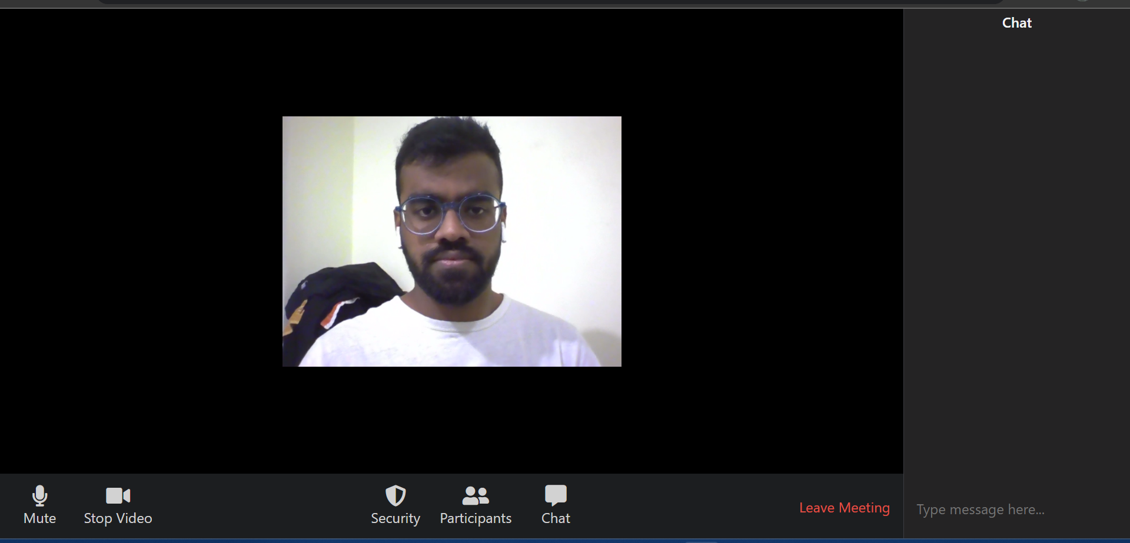
Meet Platform Screenshots

Slide 15
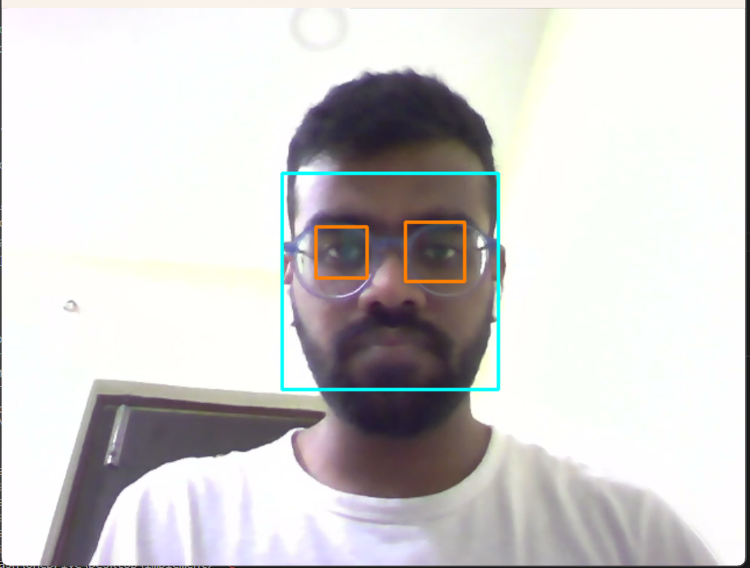
Meet Platform Screenshots

Slide 16
Thank You

